Slide 1
JOINT UN-GGIM: EUROPE – ESS - UNECE MEETING ON THE INTEGRATION OF STATISTICAL AND GEOSPATIAL INFORMATION
LUXEMBOURG, 24 MARCH 2021
UN-GGIM: Europe Working Group
on Core Data
Report and update
Clément Godin
Dominique Laurent
France

Slide 2
Table of contents
General State of Play
Core Data and High Value Datasets

Slide 3
General State of Play

Slide 4
Reminder
Annex III
Statistical units
Buildings
Soil
Land use
Human health and safety
Utility and governmental services
Environmental monitoring facilities
Production and industrial facilities
Agricultural and aquaculture facilities
Population distribution - demography
Area management/restriction/regulation
Natural risk zones
Atmospheric conditions
Meteorological geographical features
Oceanographic geographical features
Sea regions
Bio-geographical regions
Habitats and biotopes
Species distribution
Energy resources
Mineral resources
Selected Core Data Themes
Annex I
Coordinate Reference Systems
Geographical Grid Systems
Geographical Names
Administrative Units
Addresses
Cadastral Parcels
Transport Networks
Hydrography
Protected Sites
Annex II
Elevation
Land Cover
OrthoImagery
Geology

Slide 5
Global State of Progress
Theme | Analysis | Decision making |  |  |  |  | Draft Deliverable |  | Consolidated Draft After WG A Review |  | Final Deliverable After General Review
AD
AU
BU
CP
GN
SU
US
AM
OI
EL
TN
HY
LC
LU
The most advanced
Good progress
In development

Slide 6
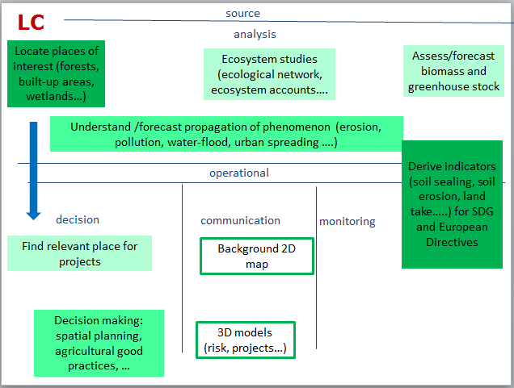
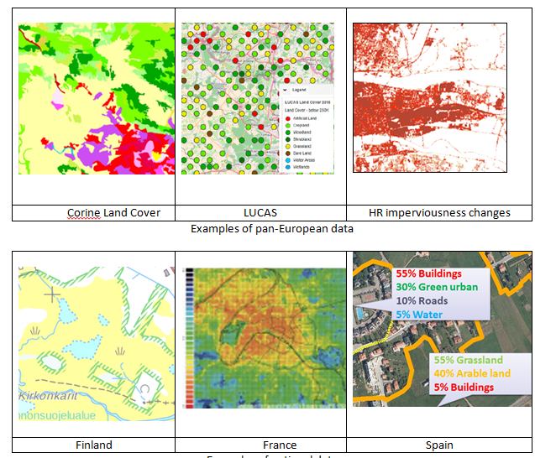
Progress on Land Cover
LC are very useful data
  ⇨ They deserve to be core data
But it isnot “reference data”
  It is generalised data
  With different points of view
Difficult to agree
on common solution
  e.g. the INSPIRE model
  is very flexible

Slide 7
Progress on Land Cover
LC data are often used to assess evolutions
  ⇨ there is need for temporal series
  Corine Land Cover has been captured
  as different dates from 1990
Core recommendation
is to ensure the continuity of CLC

Slide 8
Progress on Land Cover
There is need for large scale data and trends to capture it
Core data is proposing a flexible approach
  Recommendations about target product
    Target scale 1:10 000 or larger
    Whole partition of territory
  Recommendations about methodology
    Find national agreement about common product
    Separate LC and LU concepts (different products or different attributes)

Slide 9
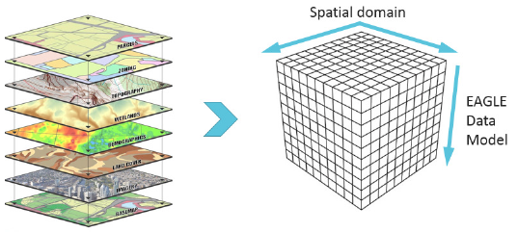
Progress on Land Cover
There are many evolutions regarding activities on Land Cover under
⇨ lots of considerations for future
  New production methods (use of Sentinel data, VGI)
  Comparing or combining various LC-LU products
  Helping users to exploit new and complex LC products
  LC data and indicators
  Production of historical LC data
  Using other geometries (e.g. 3D)
Notes:
Je crois que le WG B a travaillé sur la notion de Data Cube pour l’intégration des données géo et stats. Y faire éventuellement référence.

Slide 10
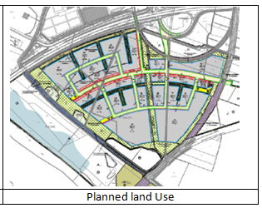
Progress on Land Use
Planned Land Use
    Kind of regulated zones
    Recommendations are very closed
    to the ones of theme “Managed or regulated zones”
      Main objective is to ensure easy access to data
      Mainly by digitalisation (if not yet the case)
    With the Land Use information in addition

Slide 11
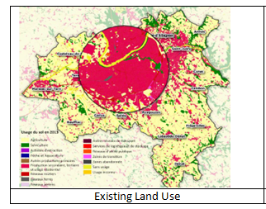
Progress on Land Use
Existing Land Use
  Core recommendation
  about large scale product
  With the same approach as for Land Cover
    Recommendations about target product
      Target scale 1: 10 000 or better
      Whole partition of territory
    Recommendations about methodology
      Find national agreement about common classification
      Ensure consistency between data specification and main source data

Slide 12
Core Data and High Value Datasets

Slide 13
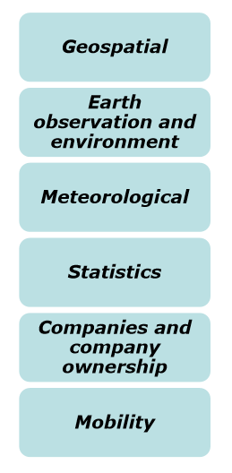
Overview
 | Core Data | High Value Datasets
Key purpose | Priority data for SDGs | Data in scope of the Open Data Directive – Article 14
Actors | UN-GGIM: Europe Regional Committee Working Group A | European Union Impact Assessment Study: Cabinet Deloitte
Objective | Recommendations for content | Content description & recommendations for publication as open data (Impact Assessment Study)
Scope | Geographic data | Data on 6 categories

Slide 14
Selection criteria
High Value Datasets | Core Data
Generate significant socio-economic or environmental benefits |  | Core Data is priority data to analyse, achieve or monitor SDGs
and innovative services |  | Generating innovative services is not a Core Data target (but it may contribute)
Benefit a high number of users |  | Core Data should in general be accessible to everyone
In particular SMEs |  | Main target is public bodies but SMEs may also benefit from Core Data
Assist in generation revenues |  | Generating revenues is not Core Data target
Be combined with other datasets |  | Combined with other datasets, core geographic data offer wide range of applications: background map, geocoding, indicator computation …

Slide 15
Comparison exercise
Source documents
  For High Value Datasets, impact assessment study and presentations by Cabinet Deloitte (PPT)
      Webinar on 28/07/2020
      Webinar on 04/09/2020
  For Core Data, UN-GGIM: Europe Working Group A deliverables
      Selection of core themes
      Recommendations for content for each selected theme
Review phase
by Member States

Slide 16
Comparison results (methodology)
 | UN-GGIM: Europe Core Data | HVD impact assessment study
Rationale for choice | Rationale for choice was investigated and published | Rationale for choice not exposed
INSPIRE influence | Strong (preliminary list of potential themes, use of INSPIRE terminology) | Weaker (other themes, terminology not always consistent)
Priorities | 2 levels Core recommendations Good practices ⇨ step-wise implementation | 2 levels Lower intensity intervention Higher intensity intervention ⇨ option to be chosen for regulation

Slide 17
Comparison exercise (theme selection)
prices
SU
AU
GN
AD
BU
CP
finance
trade
business
Geospatial
tourism ...
PD?
HH?
EL
HY
LC
LU
OI
PS
AM
Statistics
GE
SO
OF
SR
NZ
EF
Companies
BR
SD
HB
Environmental data (noise, air quality, waste …)
Earth observation and environmental data
Core data
MF
AC
TN
US -Basic services
Meteorological
Mobility
INSPIRE

Slide 18
Analysis of selected HVD themes by the impact study
Comparison with UN-GGIM Europe core data
  HVD has wider scope ⇨ more themes
  Most of core data themes are considered as HVD
  Only 2 missing themes in HVD
    Statistical Units (but some overlap with administrative units)
    Basic services
  Difficult to evaluate HVD selection as rationale is not exposed in the impact assessment study

Slide 19
Analysis of selected HVD themes by the impact study
Comparison with INSPIRE
  Themes missing in HVD
    Facilities: governmental (US), agriculture (AF), industrial (PF)
    Resources : mineral (MR), energy (ER)
    Area Management (AM)
  Additional themes in HVD
    Economic statistics
    Companies

Slide 20
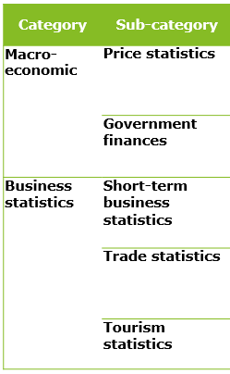
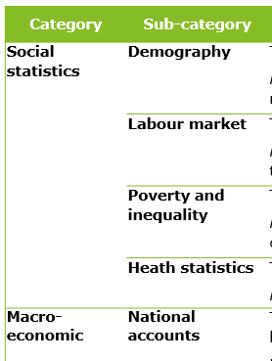
Zoom on Statistics category
INSPIRE theme SU not included
in HVD
ESS data sets
(already freely available)
List of HVD datasets
Unclear status of ESS data sets:
in or out HVD?

Slide 21
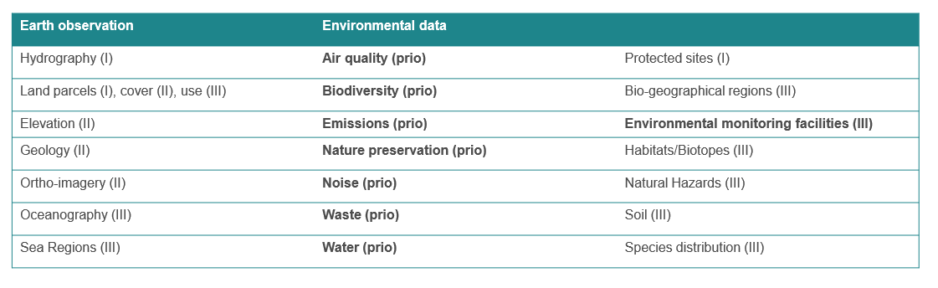
Comparison exercise (priorities for EO data)
First HVD priority is on specific data for environmental reporting whereas core data focus on basic data (INSPIRE themes) required by a wide range of use cases.

Slide 22
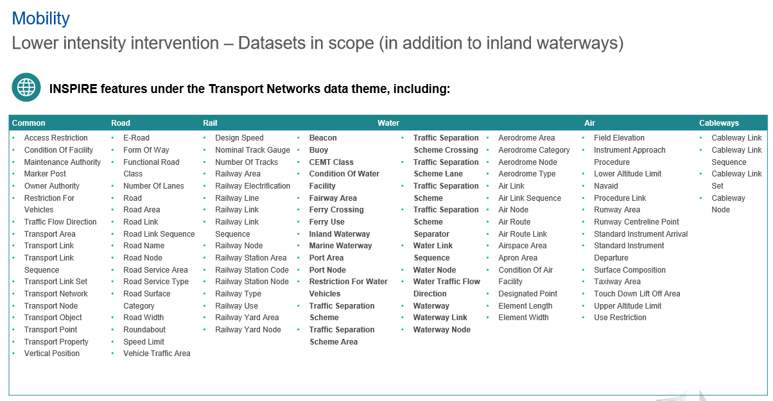
Comparison exercise (priorities for mobility)
First HVD priority is on water transport network whereas core data includes rich information on road transport and more basic one on railway, water and air transport

Slide 23
Conclusions
Core Data and HVD
  Different contexts and objectives
  Common principle for selection: wide use
Some different points of view on “EO” and “Mobility”
  HVD impact study: candidate priority HVD is addressing dedicated data (e.g. to reporting for European Directives, to Water Transport)
  Core data is focusing on widely used data (e.g. richer model for data on road than on water transport)
Most of UNGGIM core data is considered as high value data by the HVD impact study

Slide 24
Conclusions

Slide 25
Conclusion
Final deliverables
  Available for 4 core themes
  Almost ready for 8 core themes
Reflections on Land cover and Land use in progress
  Despite the health situation
More than ever, the core data remains relevant
  In an European context (High Value Datasets)

