Slide 1
Joint UN-GGIM Europe – ESS meeting on the integration of statistical and geospatial information
11 March 2016
Key note on SDG indicators
fritz.gebhard@ec.europa.eu
Eurostat

Slide 2



From MDGs to SDGs
MDGs
SDGs
2000 – 2015
2016 – 2030

Slide 3


















2030 Agenda: 17 Sustainable Development Goals (SDG) …

Slide 4
… and 169 SDG targets!

Slide 5
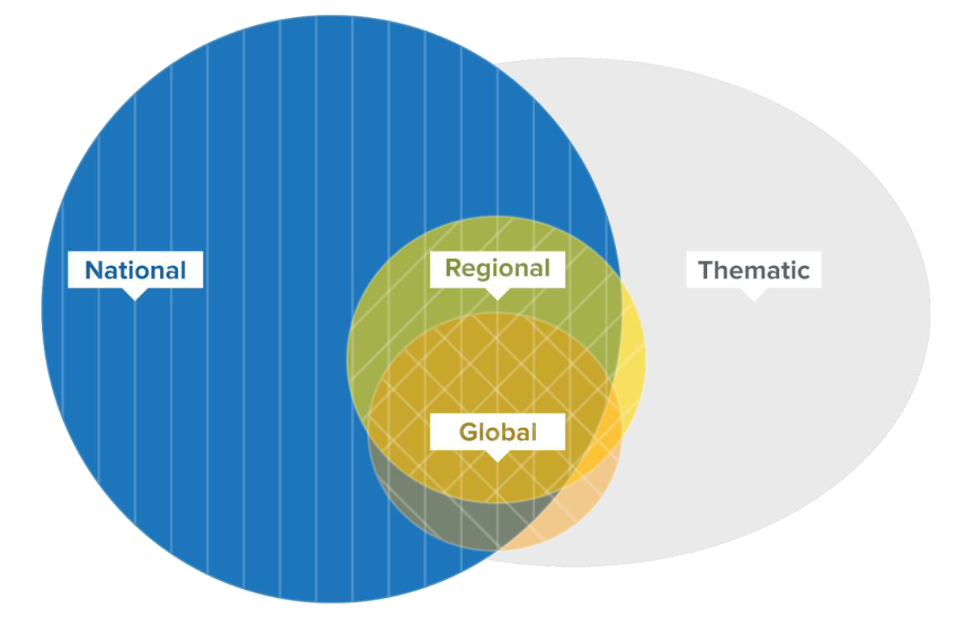
Different levels of SDG monitoring
Global monitoring:
based on a core set of global indicators
harmonised to common global standards
predominantly taken from official data
applicable to all countries
each of the 169 targets should be measured

Slide 6
Inter-agency and Expert group on SDG indicators (IAEG-SDGs)
Mandated by the 46th UNSC to develop an indicator framework for the goals and targets of the 2030 agenda at the global level, and to support its implementation.
Members:
NSI representatives of 28 countries
(including 5 EU-MS: DE, FR, NL, SE & UK)
co-chaired by the Philippines & Mexico
regional and international agencies as observers
(including Eurostat, OECD etc.)

Slide 7

Developing global SDG indicators
March 2015: Technical
report to IGN session
List of preliminarily proposed
SDG indicators
June 2015: 1st IAEG-SDGs meeting in New York
Consultation rounds on SDG indicator proposals
October 2015: 2nd IAEG-SDGs meeting in Bangkok
Consultation rounds on
GREEN & GREY indicators
IAEG-SDG report
including final list of 241
proposed SDG indicators (Annex IV)
June/July 2016
Release of SDG
baseline report for
global monitoring
providing data and
identifying gaps
March-Dec 2016
Possible release of
national and regional
baseline data
reports
2016 – 2020
Scaling-up of national, regional and global capacities to monitor the 2030 Agenda
46th UNSC session; March 2015
47th UNSC session; March 2016
Adoption of SDG indicator set
by ECOSOC & UN-GA

Slide 8
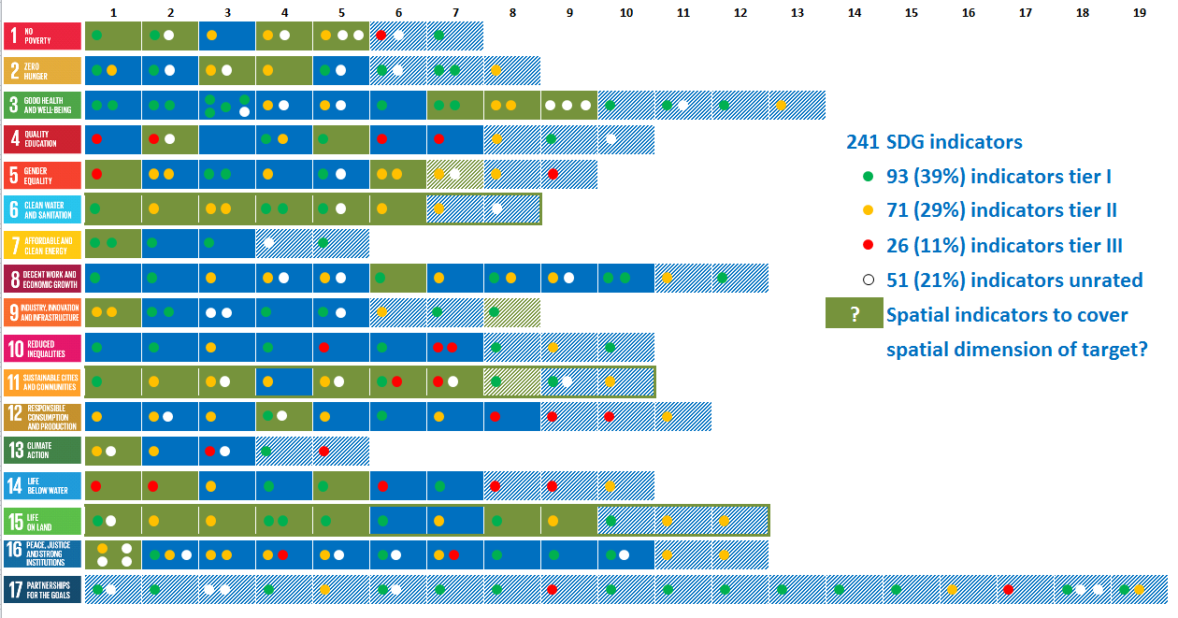
Proposed global SDG indicator set

Slide 9
Tier system for SDG indicators
Level of methodological development and overall data availability:
Methodology exists and data are widely available (tier I)
Methodology has been established but data are not easily available (tier II)
Internationally agreed methodology has not yet been developed (tier III)

Slide 10
Further work on SDG indicators
Need to fill data gaps
Need for methodological enhancements
Workstream on disaggregation
(«Leave no-one behind»)
Initial set of global SDG indicators will evolve and will be complemented with regional and national sets of SDG indicators.

Slide 11

SDGs as driver: Transformative Agenda for Official Statistics
Official data from existing basic statistics and accounts will play a major role in policy cycles
New methods to be developed and new data sources to be evaluated
Eurostat's lines of work: Big Data, geospatial information, accounting systems …
Unique opportunity for
new partnerships!

Slide 12
Indicators as part of the statistical infrastructure
Indicators
Accounting systems
(SNA; SEEA …)
Official data
Non-official data
specific
purpose
multi-purpose
SDG indicator frameworks
Geospatial information?
NSIs
others
Notes:
This slide is taken from Martine Durand’s intervention in the panel discussion at the DGINS.
It is an enhanced version of the pyramid of representing the Infrastructure of statistical information in the European Statistical Programme 2013-17 and basically summarises several of the previous points.
It shows that indicators are special in the context of the official statistical production, as they serve a specific purpose and require a context (standard message).
However, what should be highlighted above all (also shown by the pyramid) is:
the need to integrate new data sources, both from non-official statistics and by enlarging the base of official statistics.
the need to involve data scientists and other data producers.
What is probably missing in this pyramid is the role of the policy makers.

Slide 13



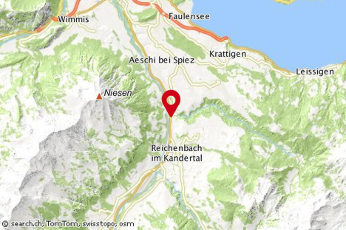
Reducing complexity by indicators
Reality is complex …
… indicators
reduce complexity.
Be aware
of risks and
side effects!
Context
matters!
Notes:
It conveys an overarching message to the statistical community that we have to grasp the new opportunities while controlling the risks.
While keeping in mind the limits of statistical measurement (slide 6), point 9 of the Lisbon memorandum calls for work to close data gaps, in particular for the SDGs. It is also related to the growing importance of social and environmental dimensions for the measurement of objective and subjective well-being and sustainable development (point j of the considerations of the memorandum).
Regarding quality aspects, the memorandum mentions:
Indicators and indicator sets need to be defined according to the following general criteria: relevance, consistency, timeliness, measurability and transparency (point 2)
Statistical indicators from European Statistics (should) comply with the statistical standards and with the quality criteria laid down in the European Statistics Code of Practice (point 4).
On composite indicators, the DGINS “Underline the need for caution if producing or communicating composite indicators, which aggregate individual indicators of different nature and that are measured in different units” (point 11 of the memorandum).
The memorandum includes no specific indication on modelling and integration of new sources
SYNTHESIZING MULTIDIMENSIONAL MEASURES, COMPOSITE/SYNTHETIC INDICATORS, SCOREBOARDS, DASHBOARDS, DISTANCE TO TARGETS: TO WHAT EXTENT IS THIS FOR OFFICIAL STATISTICS?
CAUTION: THIS IS A POTENT MEDICATION. FOLLOW THE PRESCRIBED SCHEDULE EXACTLY TO AVOID THE RISK OF POTENTIALLY SEVERE SIDE EFFECTS!
ANY OBSERVED STATISTICAL REGULARITY WILL TEND TO COLLAPSE ONCE PRESSURE IS PLACED UPON IT FOR CONTROL PURPOSES
DATA ARE THE LIFEBLOOD OF DECISION-MAKING AND THE RAW MATERIAL FOR ACCOUNTABILITY. WITHOUT HIGH-QUALITY DATA PROVIDING THE RIGHT INFORMATION ON THE RIGHT THINGS AT THE RIGHT TIME; DESIGNING, MONITORING AND EVALUATING EFFECTIVE POLICIES BECOMES ALMOST IMPOSSIBLE
POOR STATISTICAL LITERACY BECOMES A SERIOUS ETHICAL ISSUE WHEN DATA ARE USED TO DETERMINE FUNDING OR ACTIONS THAT IMPACT ON PEOPLE'S LIVES, OR WHEN THEY ARE SHARED OPENLY, ACCIDENTALLY OR IN WAYS THAT ARE UNETHICAL

Slide 14





Indicators for policy monitoring
Agenda setting
Research & negotiation
Decision
Implementation
Policy monitoring
Reformulation
e.g. post-2015 process
Role of statistical community:
Select appropriate indicators
Define quality standards
Ensure independent monitoring
Statistics
Politics
Science

Slide 15
Future of EU long-term strategies
Europe 2020 strategy on smart, sustainable and inclusive growth
Currently under review. Input: new Commission priorities, public consultation, maybe SDGs.
EU Sustainable Development Strategy (SDS)
Adapt to the SDGs or absorb into Europe 2020?
Transforming our world: 2030 Agenda for SD (SDGs)
Commission Communication including rules for monitoring expected in 2016.

Slide 16
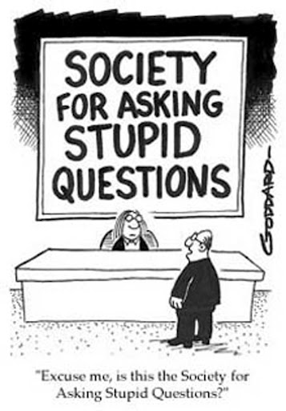
Thank you!

